Slide 1
Shopping Cart
By: Dhruti Pandya, Amish Raj & Rahul Sangewar

Slide 2
Vision:
Our e-commerce website strives to create a seamless and enjoyable shopping experience for customers. We aim to design a website that is user-friendly, easy to navigate, and visually appealing.
Our vision is to create a user-friendly platform which is scalable and easily adaptable. A platform which is straightforward to use and does not require a user to take so many steps in order to buy their basic items. Any one can purchase the product without having to create an account on the website by opting as a temporary users whose data won’t be recorded and ensuring security measures to protect our customers' information.

Slide 3
Github Repository
https://github.com/amishraj/shoppingcart
https://github.com/sangewarr/Shopping-Cart
https://github.com/Dips75/shoppingcart

Slide 4
Actors
User - Also known as buyer. Creates its account, add items into the cart, buy items, provide the ratings if any, etc.
Admin - Also known as seller. Lists and manages the inventory of the items that are to sell. Also manages the web application.
Paypal - Processes the payments.

Slide 5
Use case
Register- A user can register for an account
Login - A user can login into their account
View Inventory - View the inventory of the product(s)
Add to Cart - Add selected item(s) to cart
Checkout - Checkout the cart items to proceed to pay
Leave Rating - Old customers can leave reviews and the seller can reply to the product reviews
Manage User Info - Interact with User Info to store addresses, payment methods, and personal details of the user, and update the profile if needed
Manage Payment Info - Paypal and customers interact with the payment information of the user to fulfill the payment.
View Past Orders - A user can browse past orders and check delivery status

Slide 6
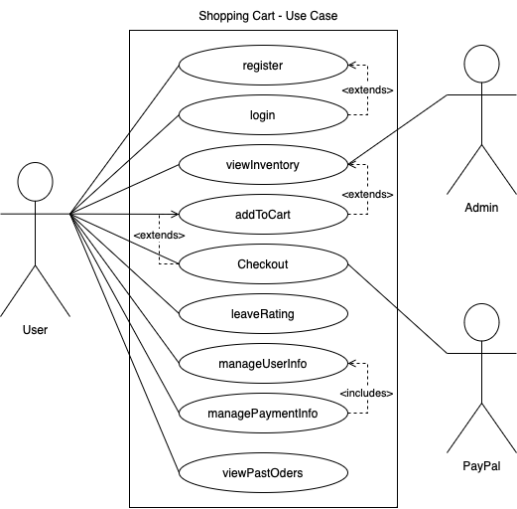

Slide 7
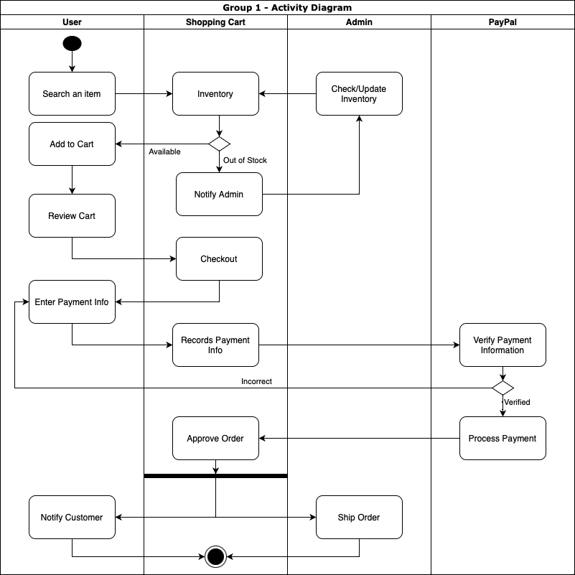
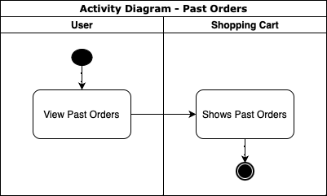
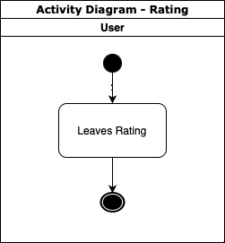
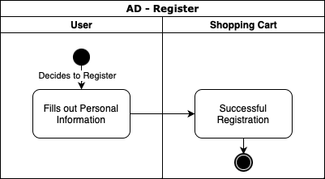
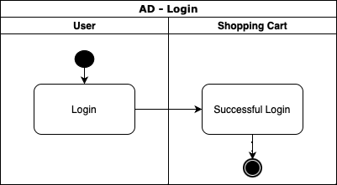
Activity Diagram

Slide 8
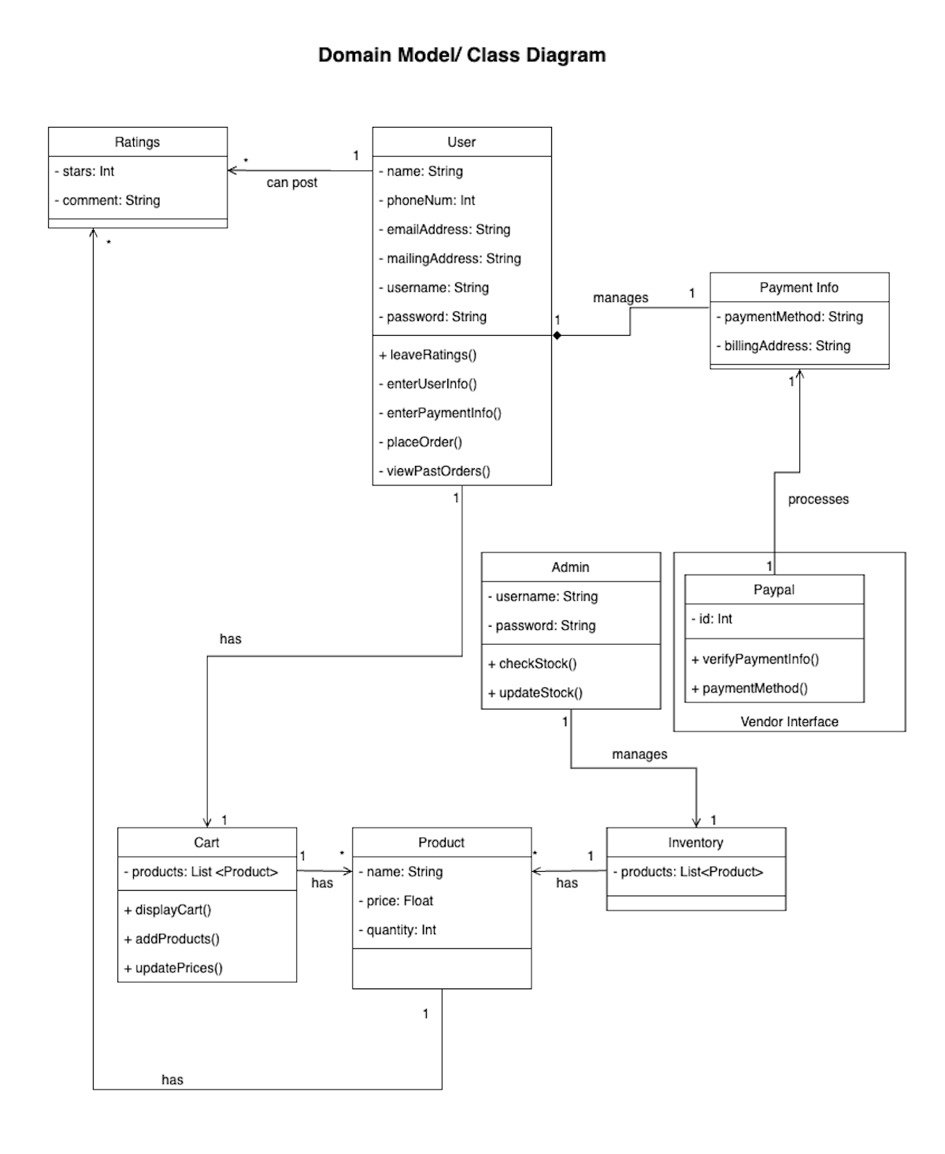

Slide 9
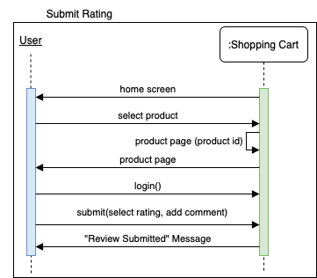
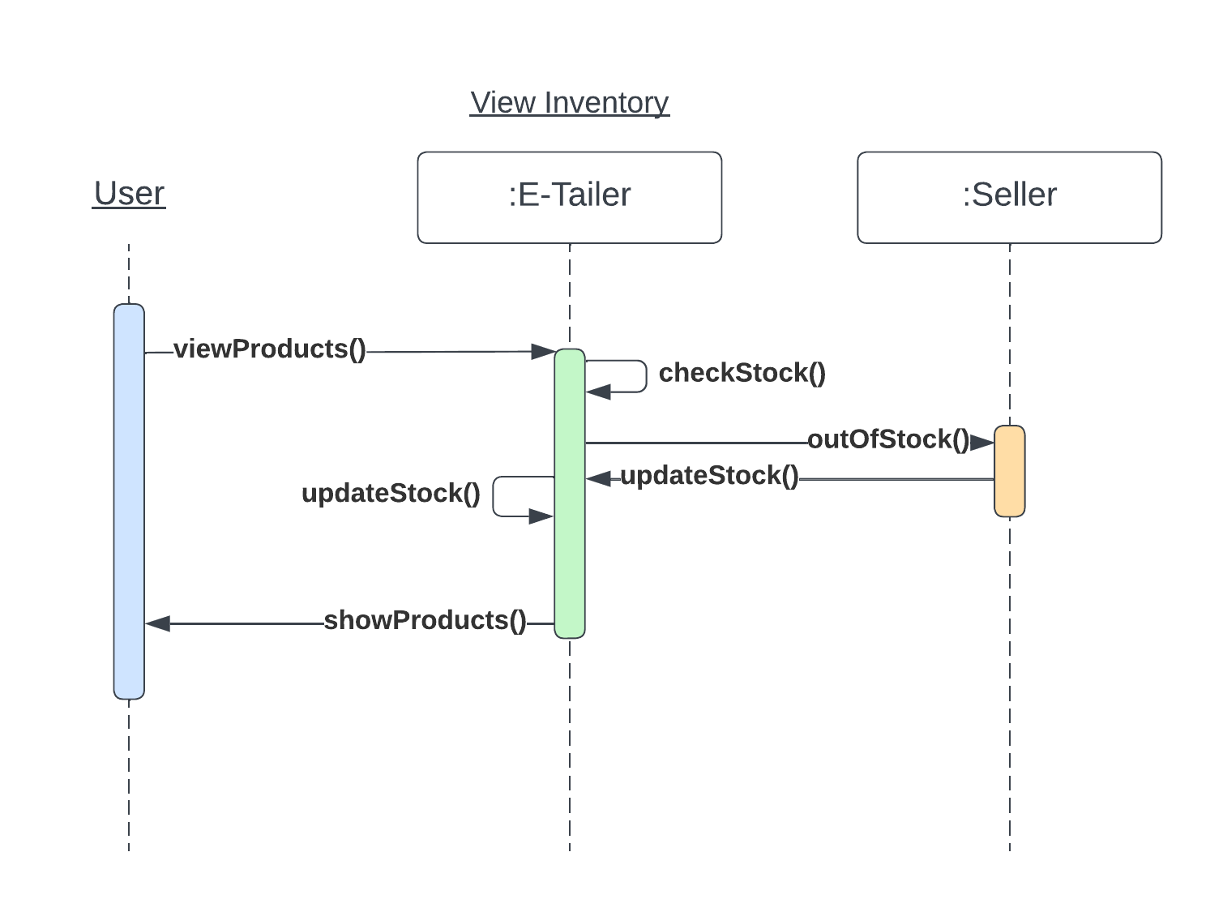
Sequence Diagram(s)

Slide 10
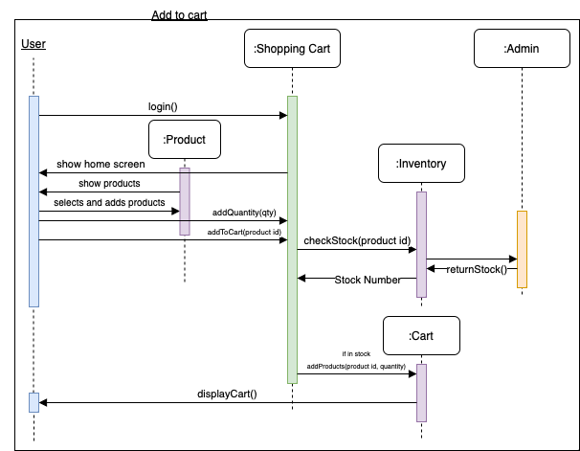
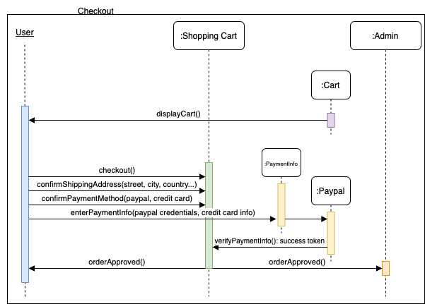
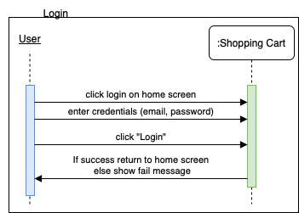
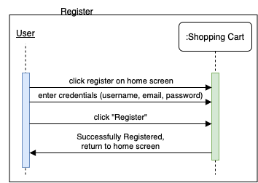
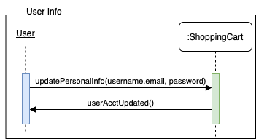
Continued..

Slide 11
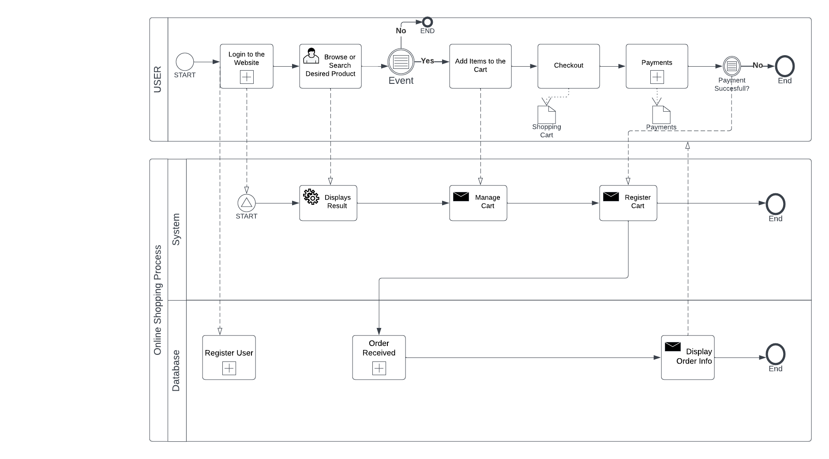
BPMN Model

